Slide 1

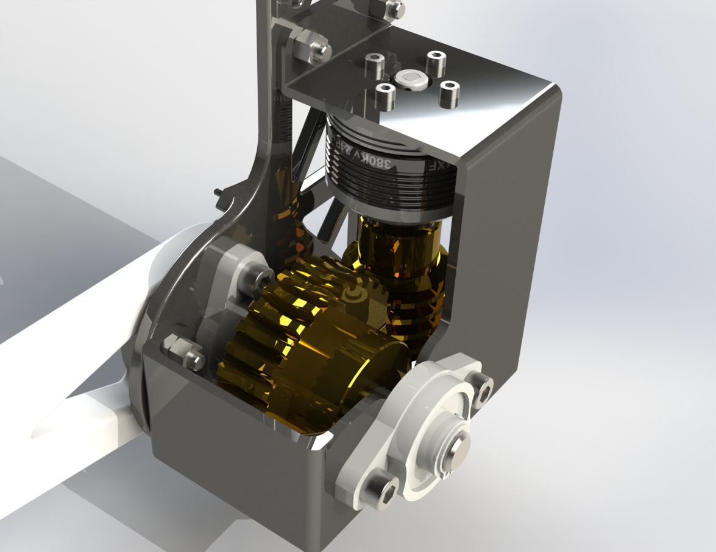
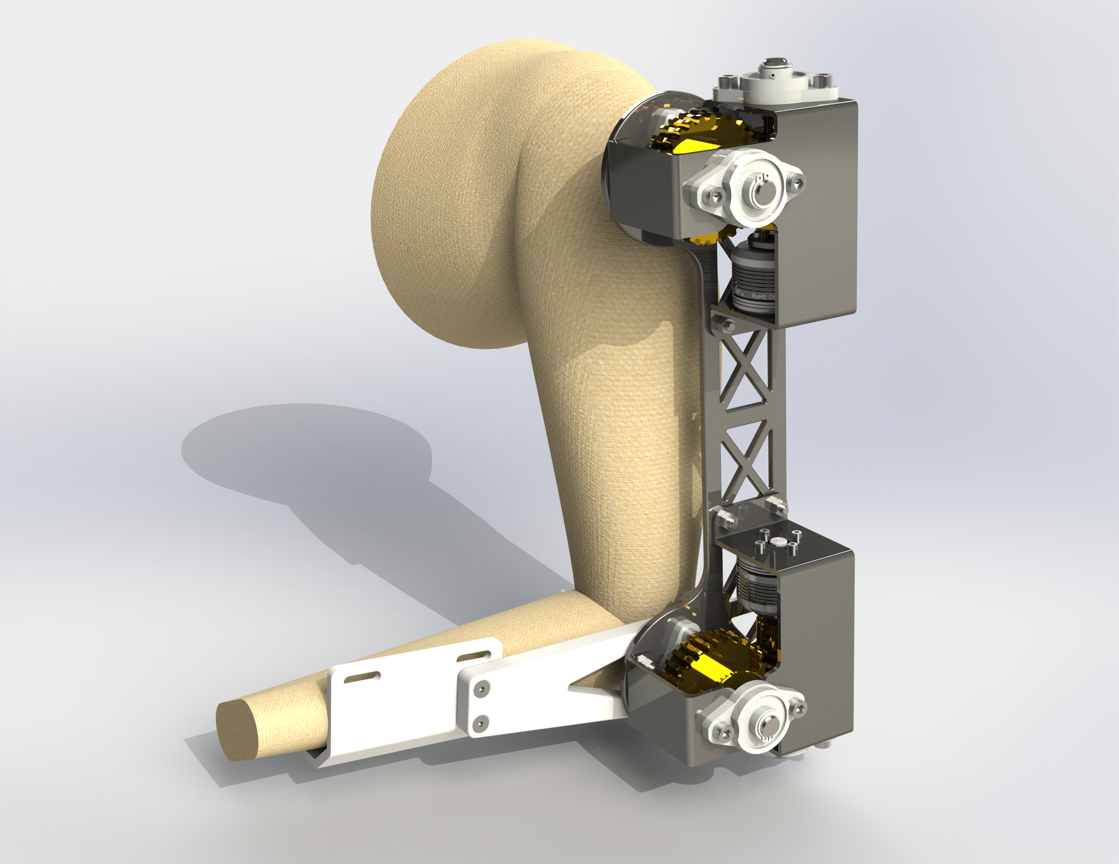
Assisted Function Exoskeleton (AFES)
Thursday, 14 December 2023

Slide 2

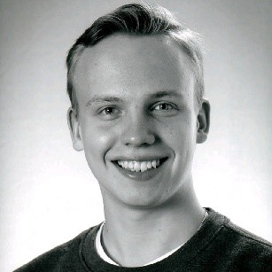
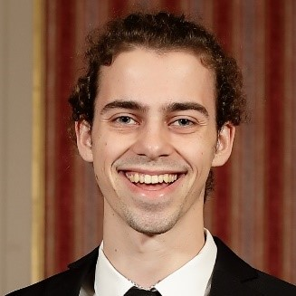
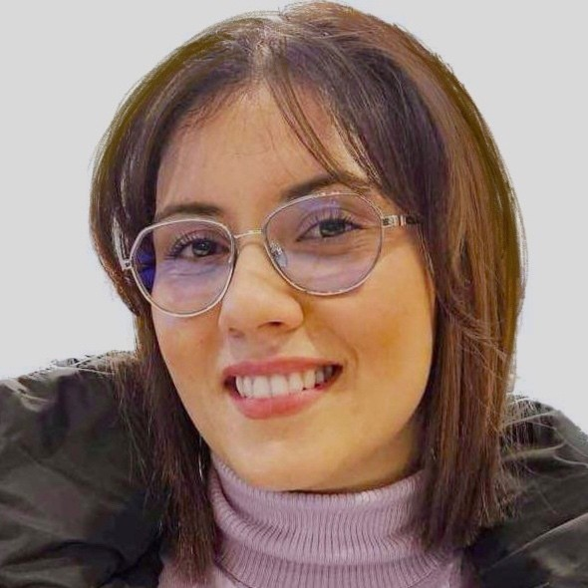

Team members
Albin Gustafsson
Hardware Team Leader
Sebastian Ahlström
Hardware Developer
Moritz Schmidt
Hardware Developer
Irini Provatidis
Software Team Leader
Jalal Taleb
Software Developer

Slide 3
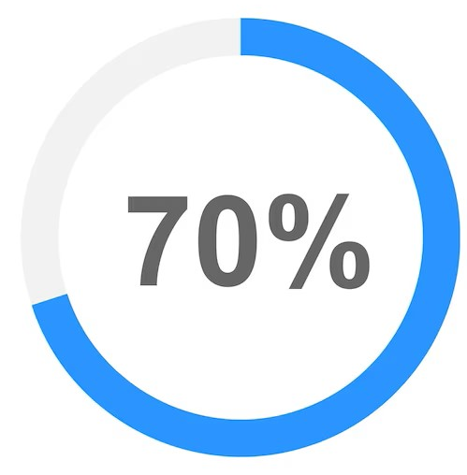

INTRODUCTION
Approximately 1.71 billion people have musculoskeletal conditions worldwide.
70 % of nurses experience back pain regularly
Notes:
In 2020, 619 million people worldwide are affected by lower backpain.
With and Ageing population, And existing demading jobs that includes heavy lifting the number is expected to rise significantly during the upcoming years
We are in need of people that are able to give care to others
But if we look into Healthcare, 70 percent of nurses experience back pain regularly.
Caused by their demanding work, our every day superheros are actually affected the most.
But what can we do?

Slide 4
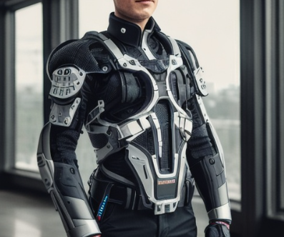
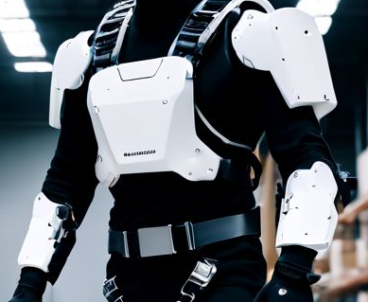
THE IDEA OF EXOSKELETONS!
A wearable robotic device boosting physical abilities.

Slide 5
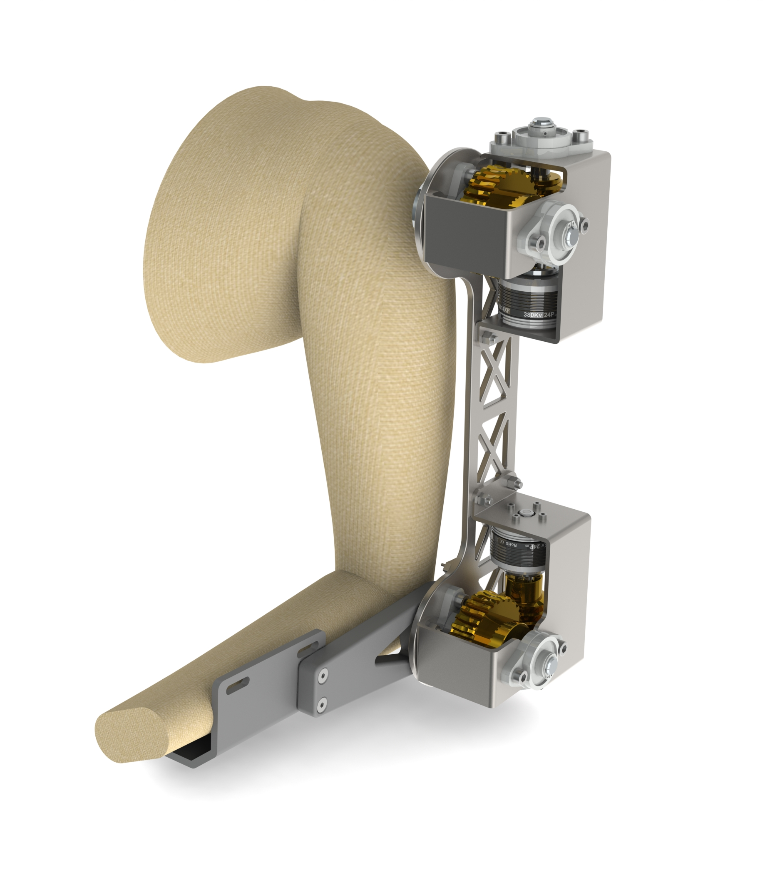
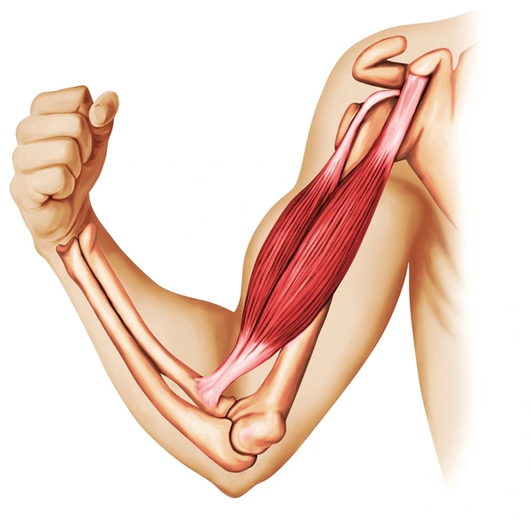
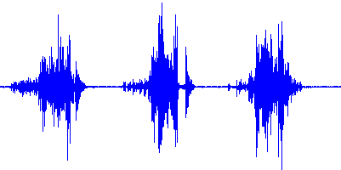
Objective Develop a prototype single-arm Assisted Function Exoskeleton, integrating electromyography (EMG) signals to carefully regulate motor rotation and torque.
Objective Develop a sophisticated prototype single-arm Assisted Function Exoskeleton, integrating electromyography (EMG) signals to carefully regulate motor rotation and torque, with the primary objective of facilitating the assistive lifting of objects through targeted activation of the bicep brachii muscle.

Slide 6

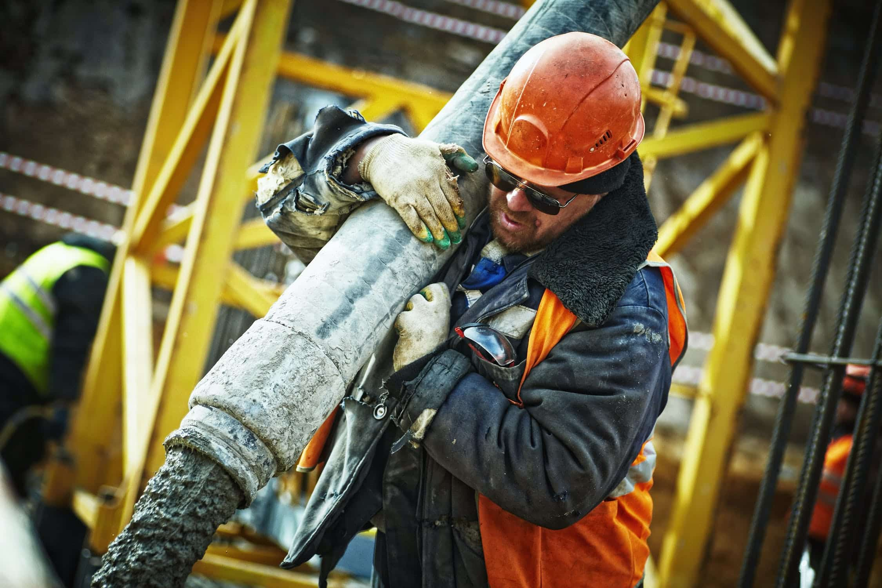
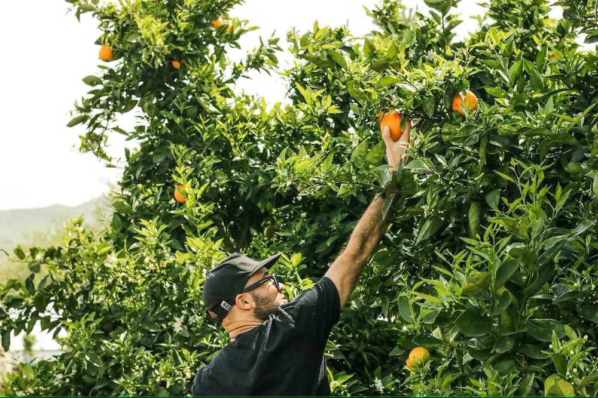
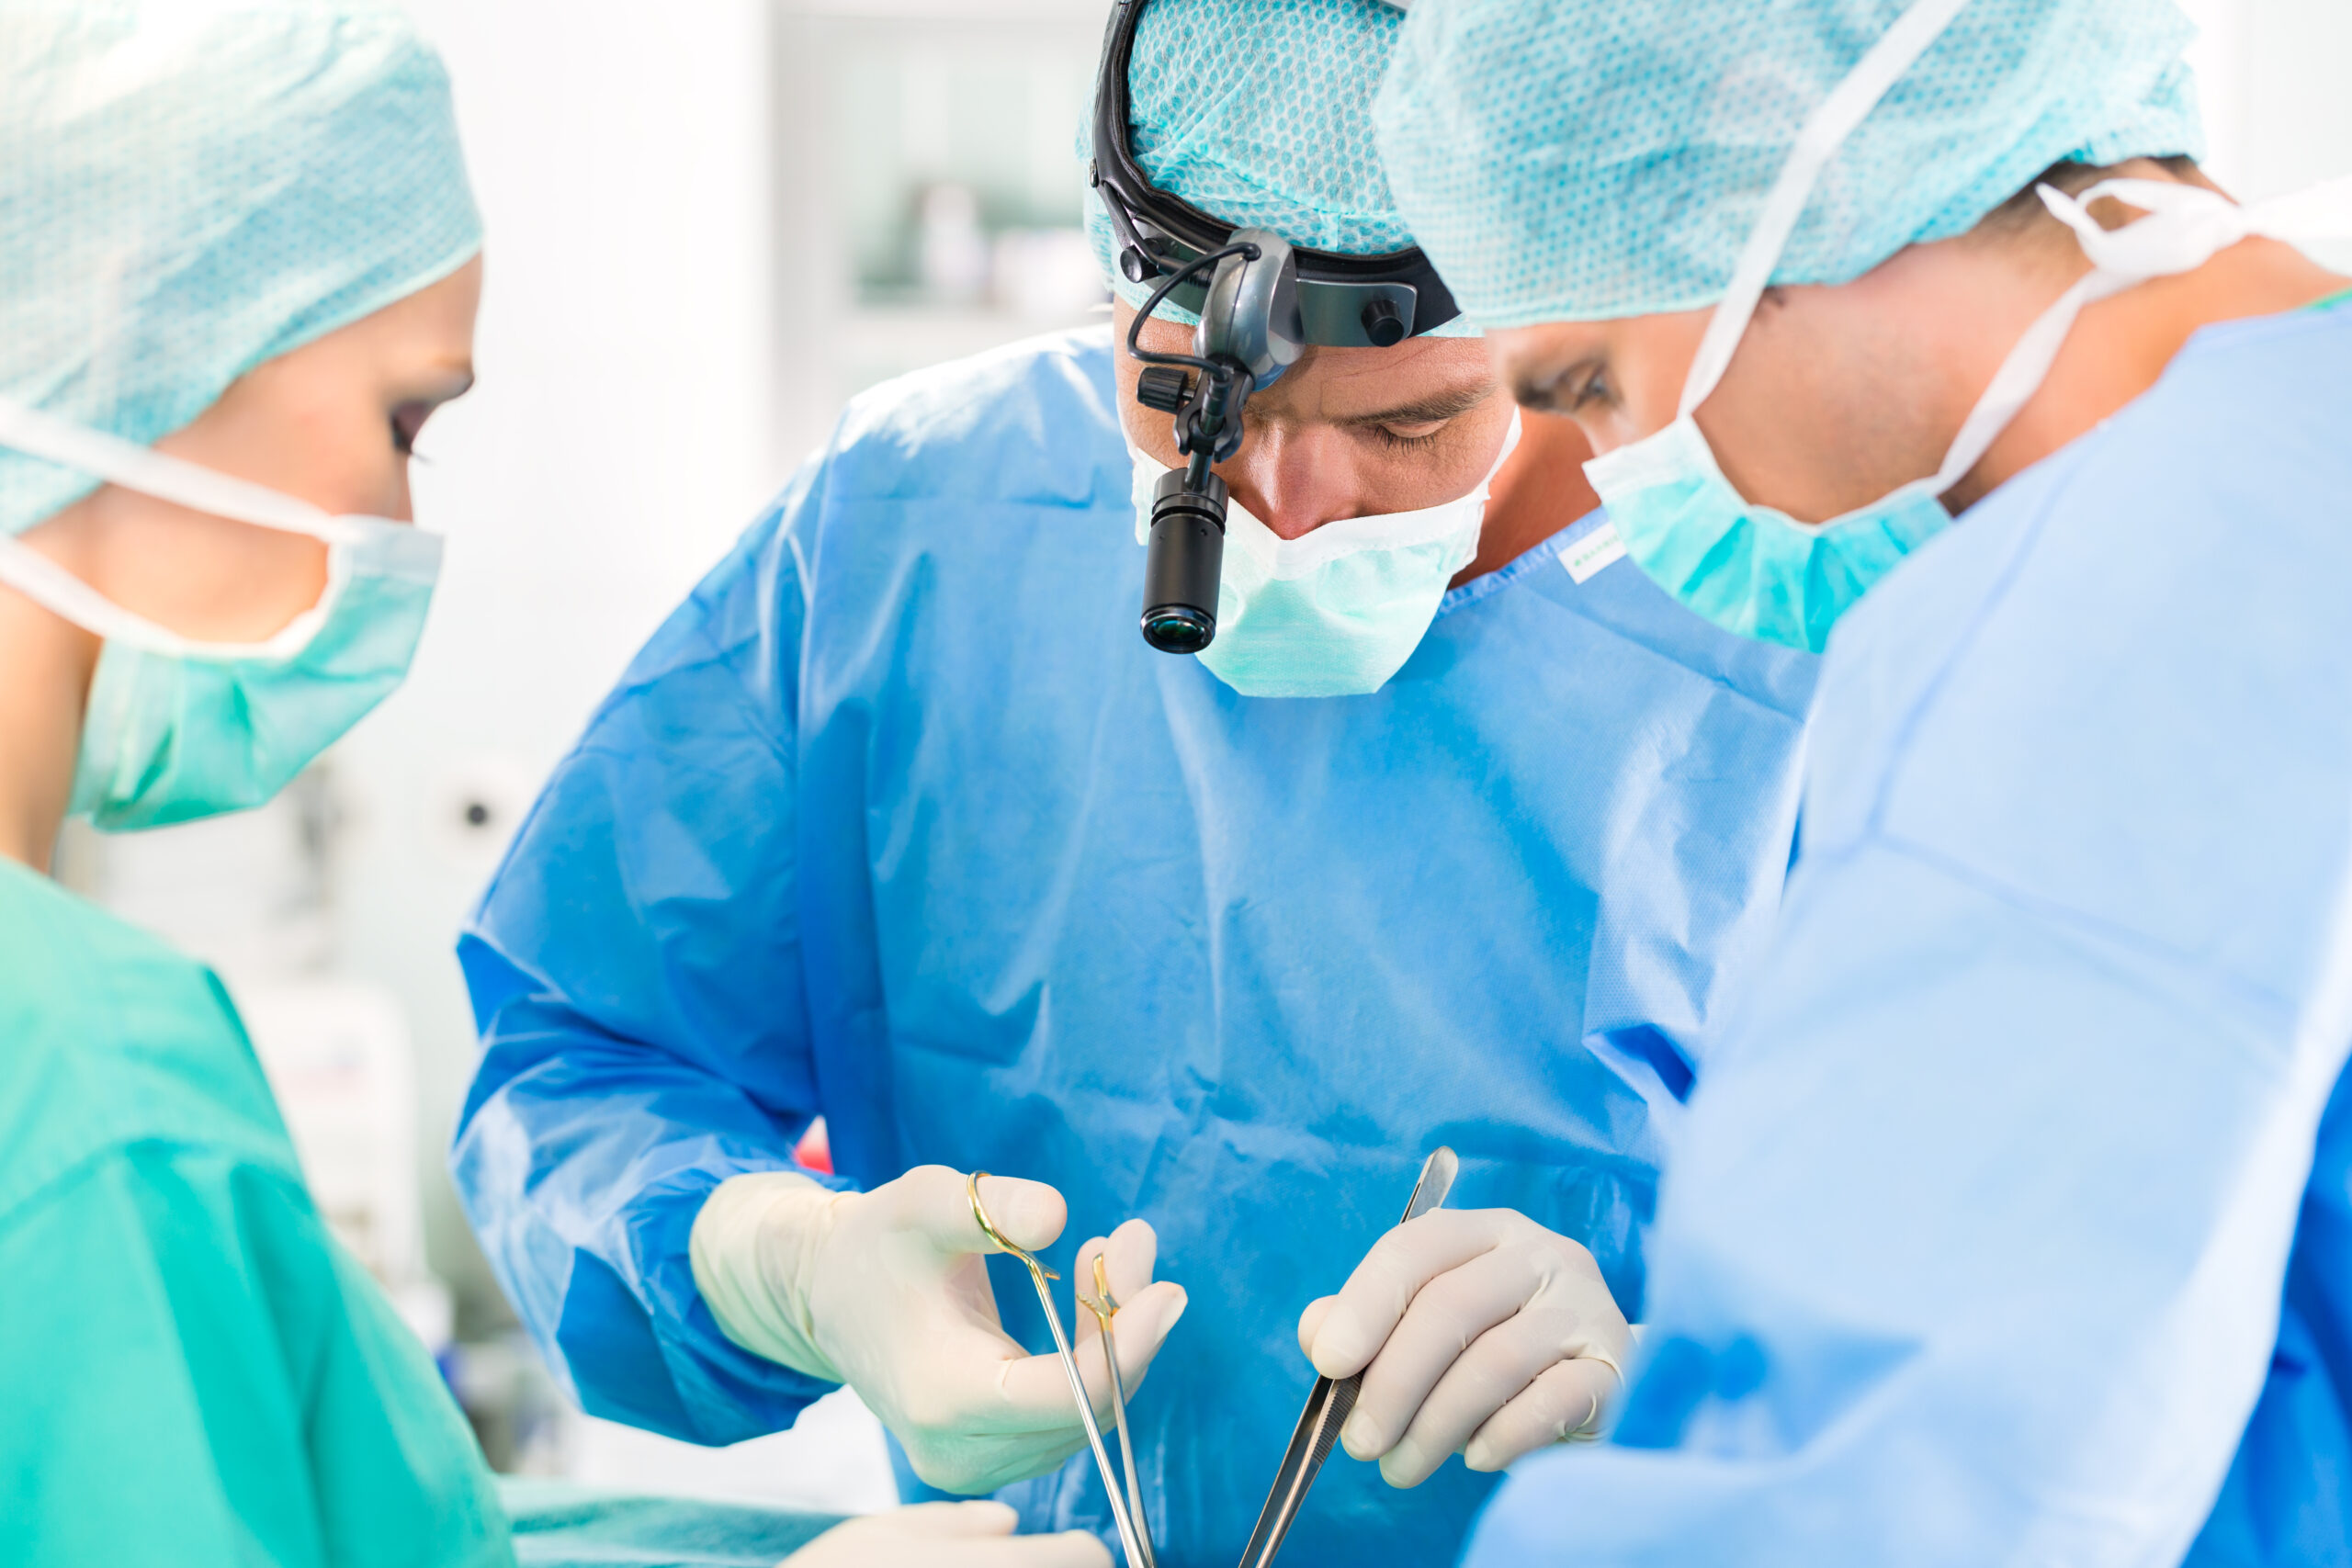
Motivation

Slide 7
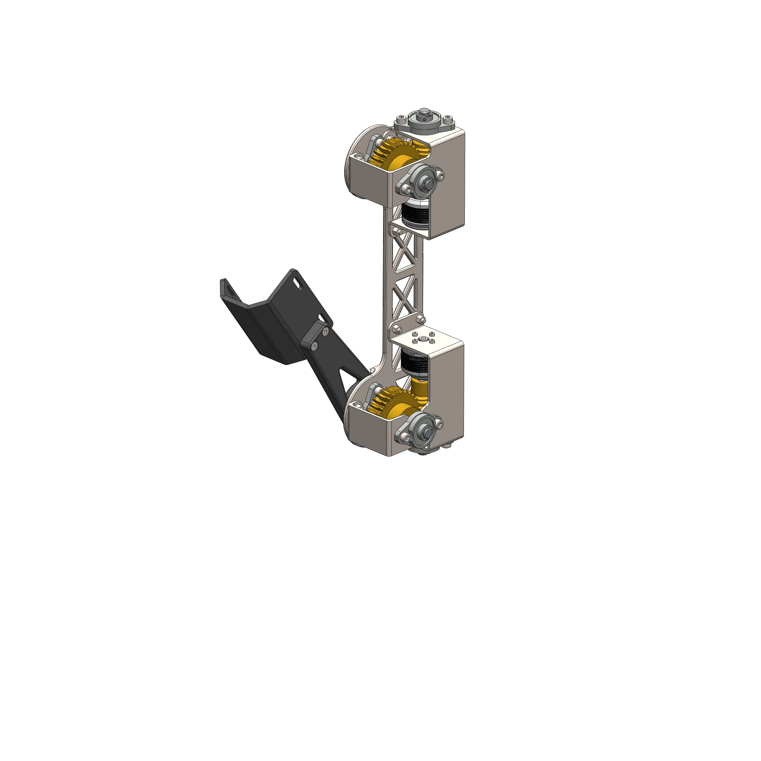
Method Hardware Highlights
Humans are complicated

Slide 8
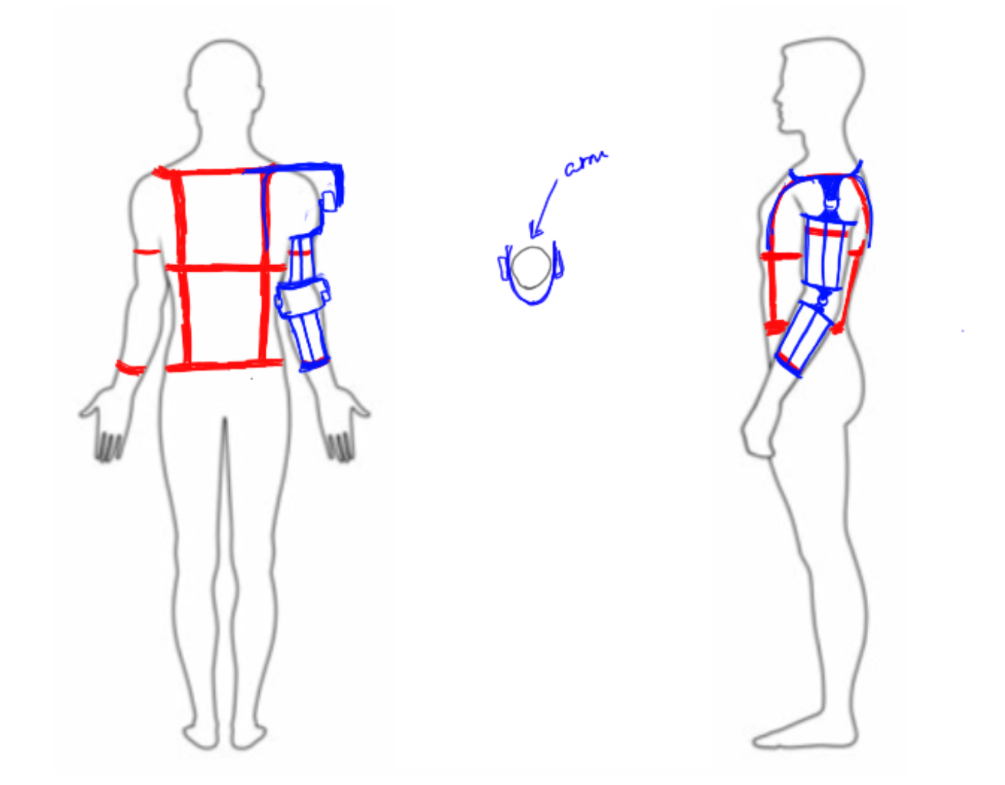
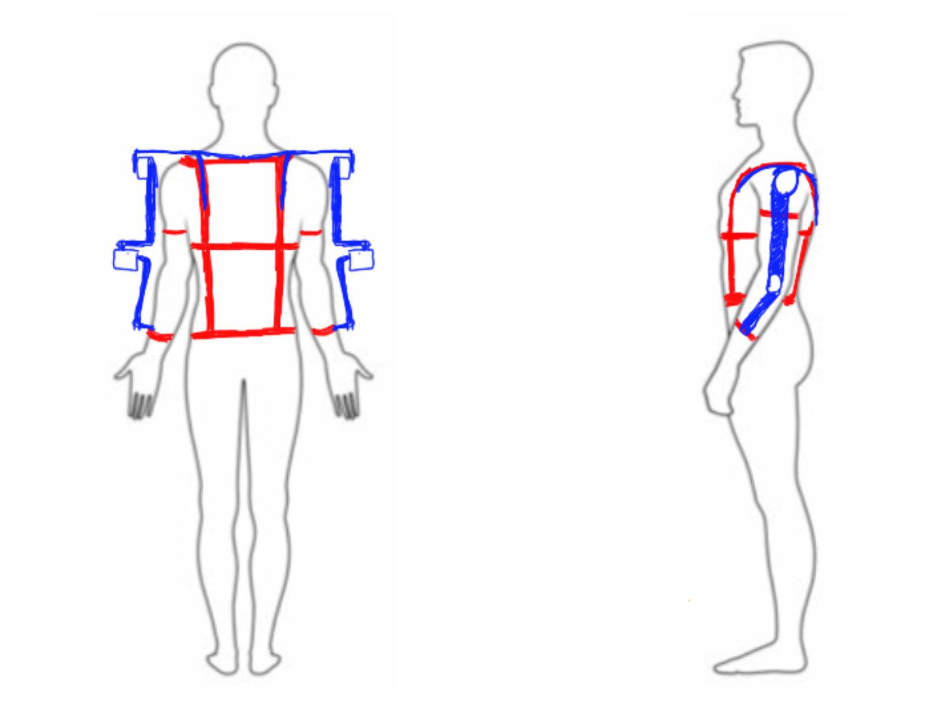
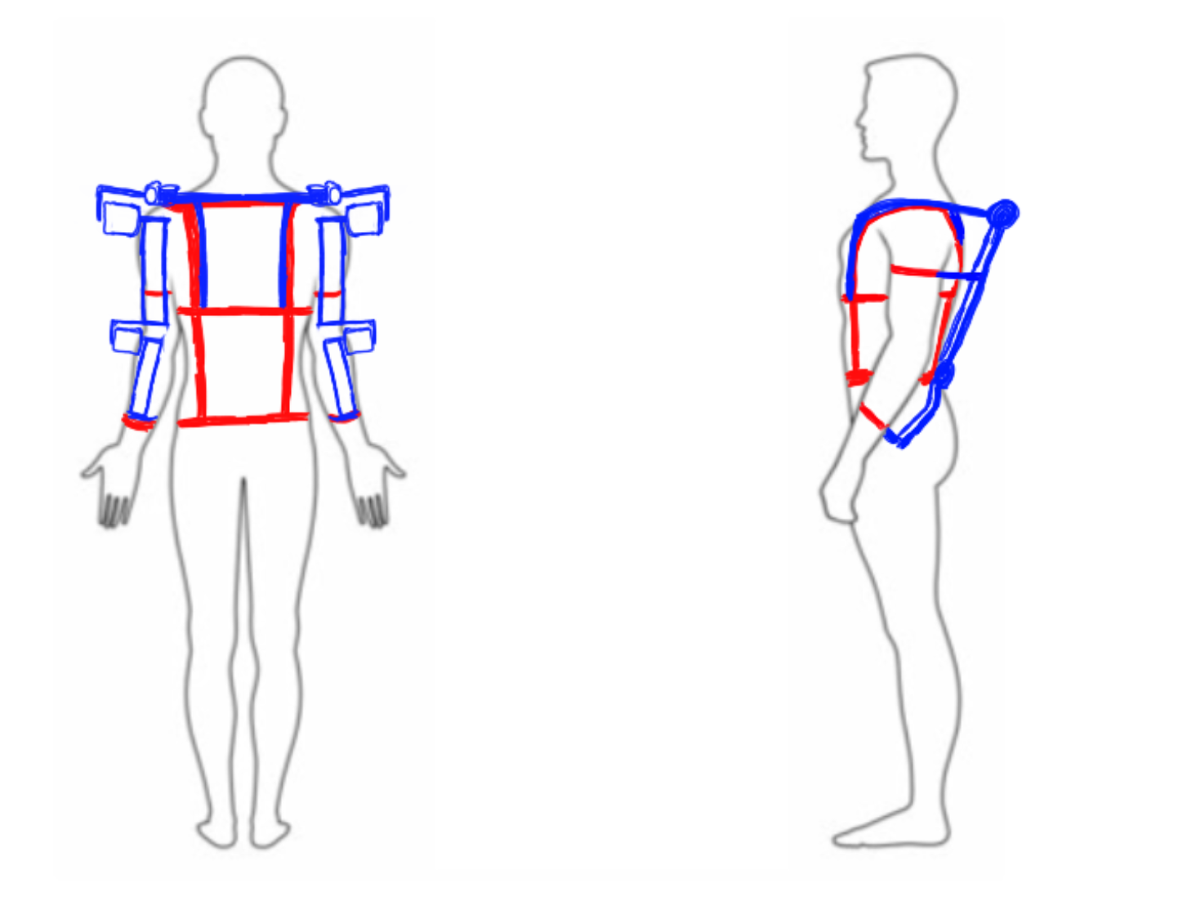
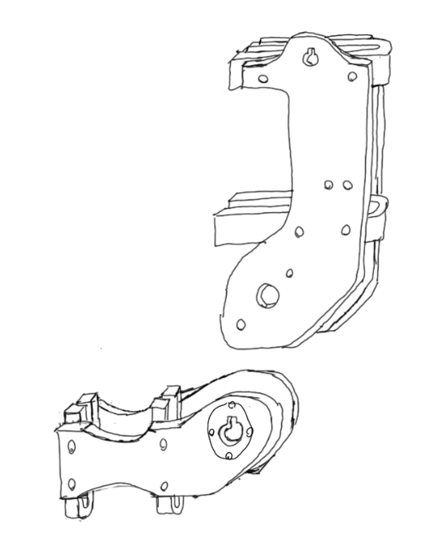
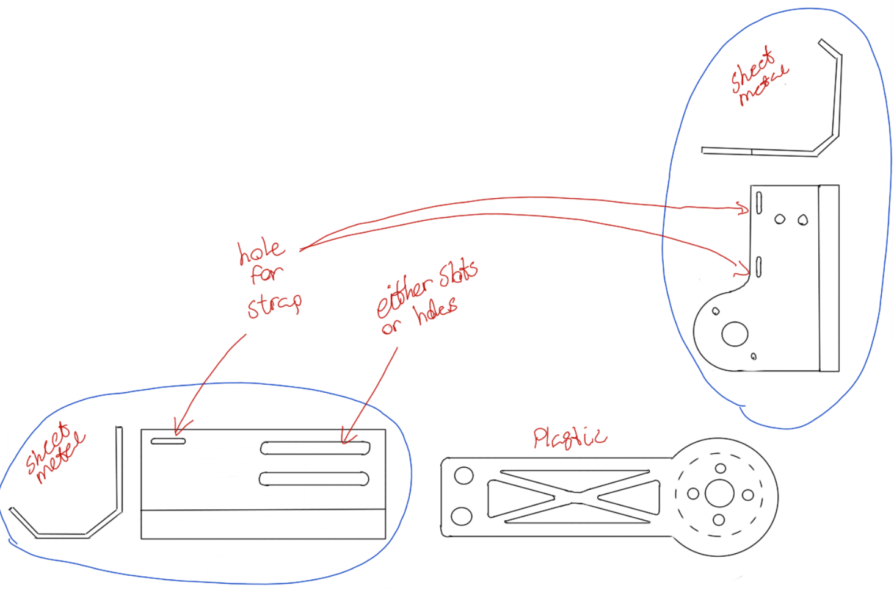
Initial Designs

Slide 9
Design
Combining metal and plastic
BLDC motors
Worm drive
Easy to assemble
Hardware failsafe

Slide 10


Myoelectric Control System (MCS).
How can we control the exoskeleton to better assist the user?
A control system based on the classification of EMG.

Slide 11
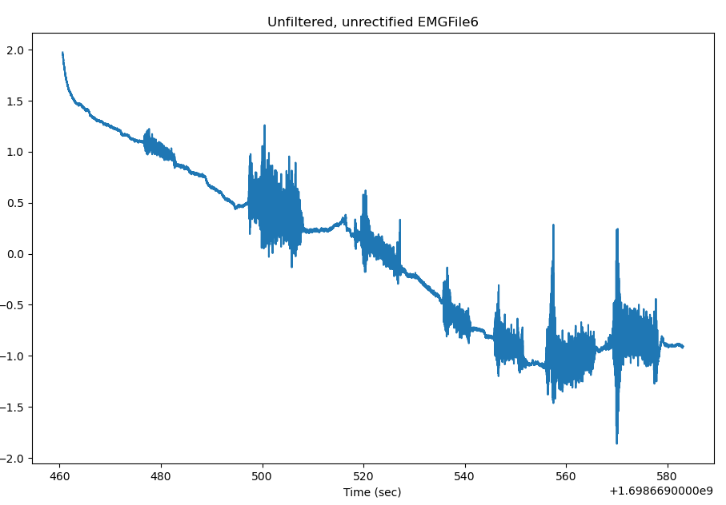
Method Software Highlights
SENSE-PLAN-ACT

Slide 12
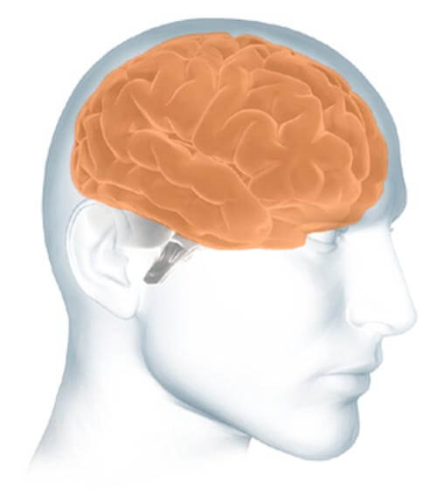
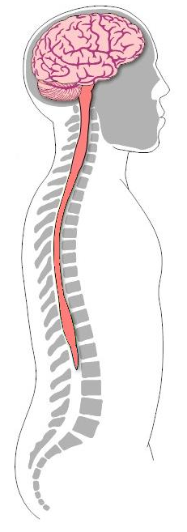
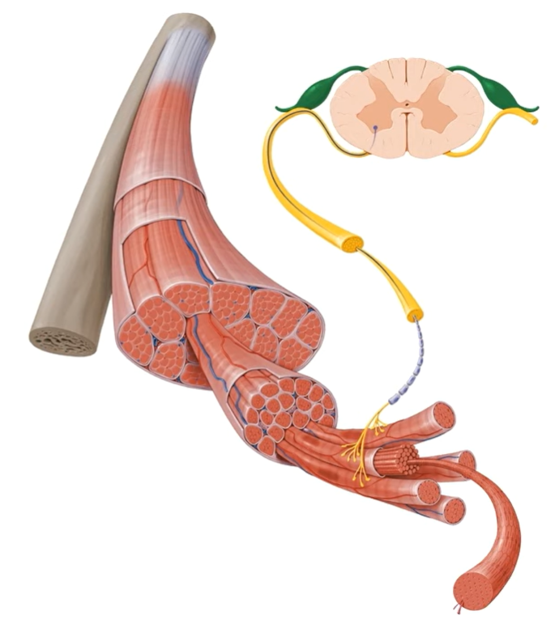
Spinal cord
CHANGE THIS TO A WHOLE SPINAL CORD
Muscle & Nerves
Spinal cord
Cross-sectional view
Muscle
Muscle activation & movement:
Brain → Spinal cord → Muscles.
Motor neuron
When a motor neuron fires and generates electrical activity.
MOTOR UNIT
Muscle fibres
The summation of the electrical activities → Motor Unit Action Potentials (MUAPs)

Slide 13
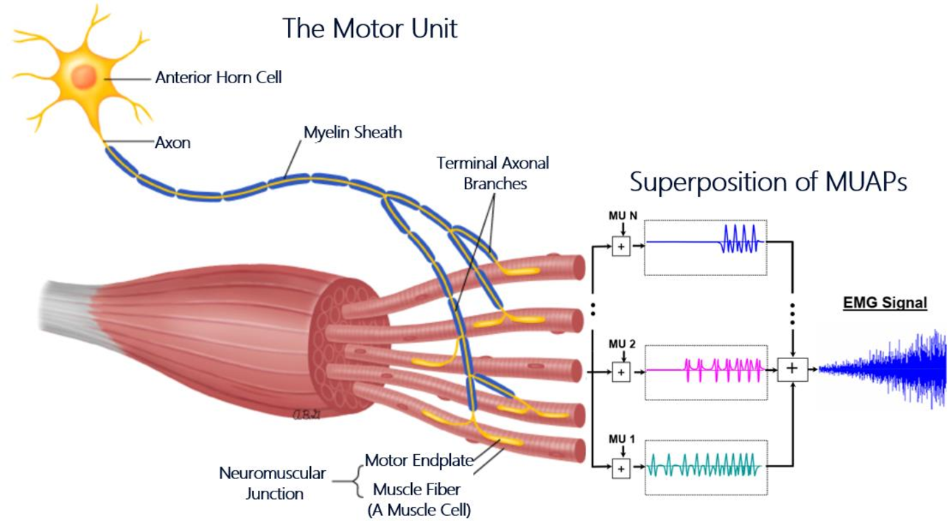
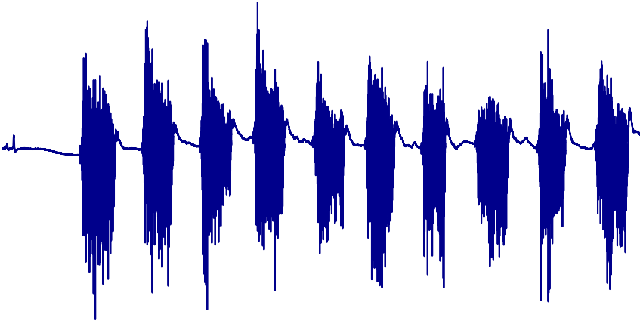
Electromyography (EMG)
“EMG is the study of muscle function through the inquiry of electrical signal the muscles emanate”, Konrad 2005
EMG signal in time domain

Slide 14
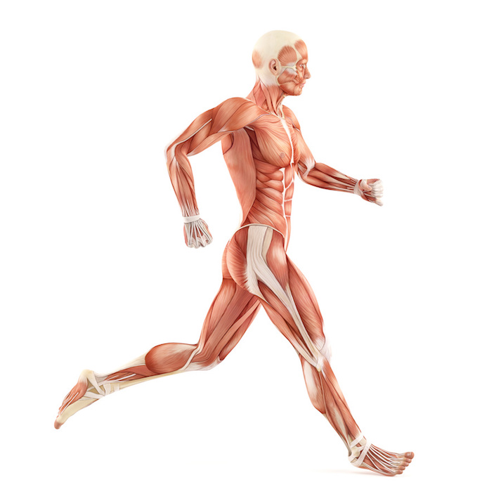
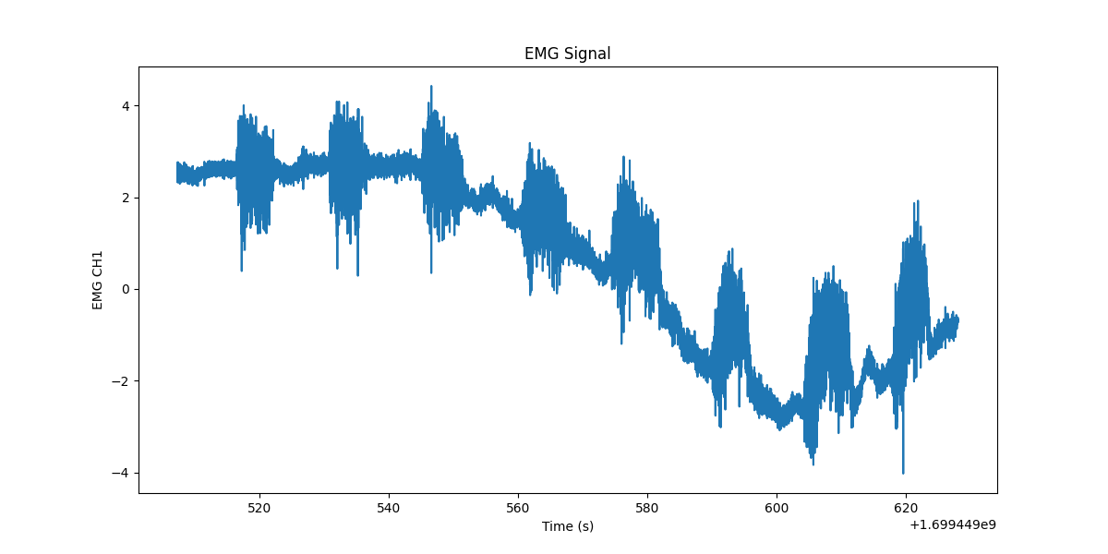
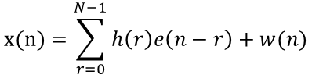
EMG basic characteristics
Muscular activity:
Anatomical and physiological properties of muscles.
Amplitude: 0 to 10 mV (peak-to-peak) or 0-1.5 mV (rms)
Frequency: 0 to 500 Hz
Usable enery: 30 to 250 Hz.
$$\text{x}\text{(}\text{n}\text{)}=\sum_{r=0}^{N−1}{h\left(r\right)e\left(n−r\right)+w(n)}$$
Anatomical and physiological properties of muscles.
This signal is a function of time. Describable in terms of its amplitude, frequency and phase.
Amplitude: 0 to 10 mV (peak-to-peak) or 0-1.5 mV (rms)
Frequency: 0 to 500 Hz but usable enery of EMG signals is dominant between 30 to 250 Hz.

Slide 15
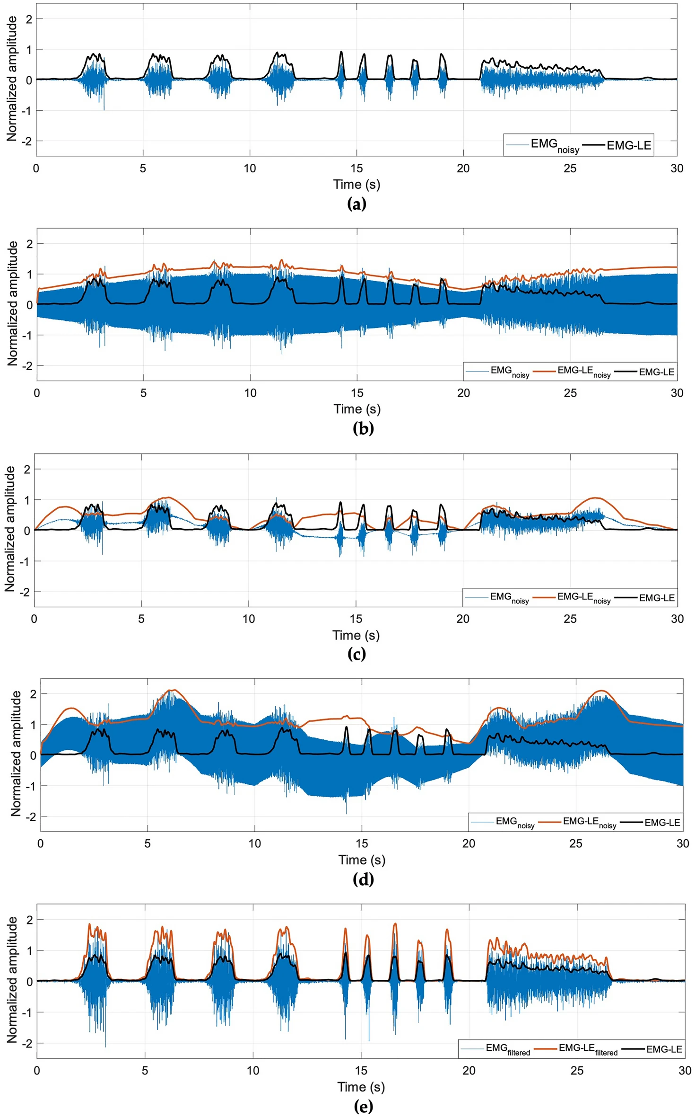
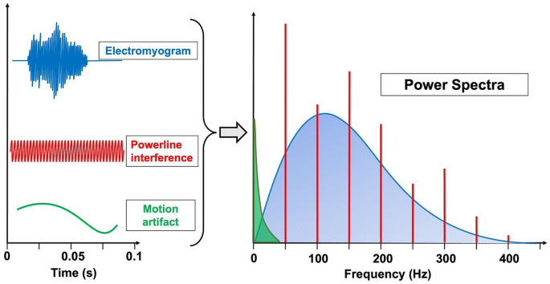
EMG common noise & artifacts
High Signal-to-Noise ratio
Inherent Noise in the Electrode
Movement Artifacts
Electromagnetic noise: Power-Line-Interference 50 to 60 Hz
Internal Noise: Number of muscle fibres per unit, depth and location of active fibres and amount of tissue.
Inherent Instability of the signal: Low Frequency Artifacts 0 to 20 Hz.
Electrocardiographic (ECG) Artifacts
White Gaussian Noise (WGN)
Cross Talk
Low Signal-to-Noise ratio.
Inherent Noise in the Electrode
Movement Artifacts
Electromagnetic noise: Power-Line-Interference 50 to 60 Hz
Internal Noise
Inherent Instability of the signal: Low Frequency Artifacts 0 to 20 Hz.
Electrocardiographic (ECG) Artifacts
White Gaussian Noise (WGN)
Cross Talk

Slide 16
The Myoelectric control system (MCS) of the Exosketon.

Slide 17

Utilize bicep muscle activity to control the exoskeleton.

Slide 18
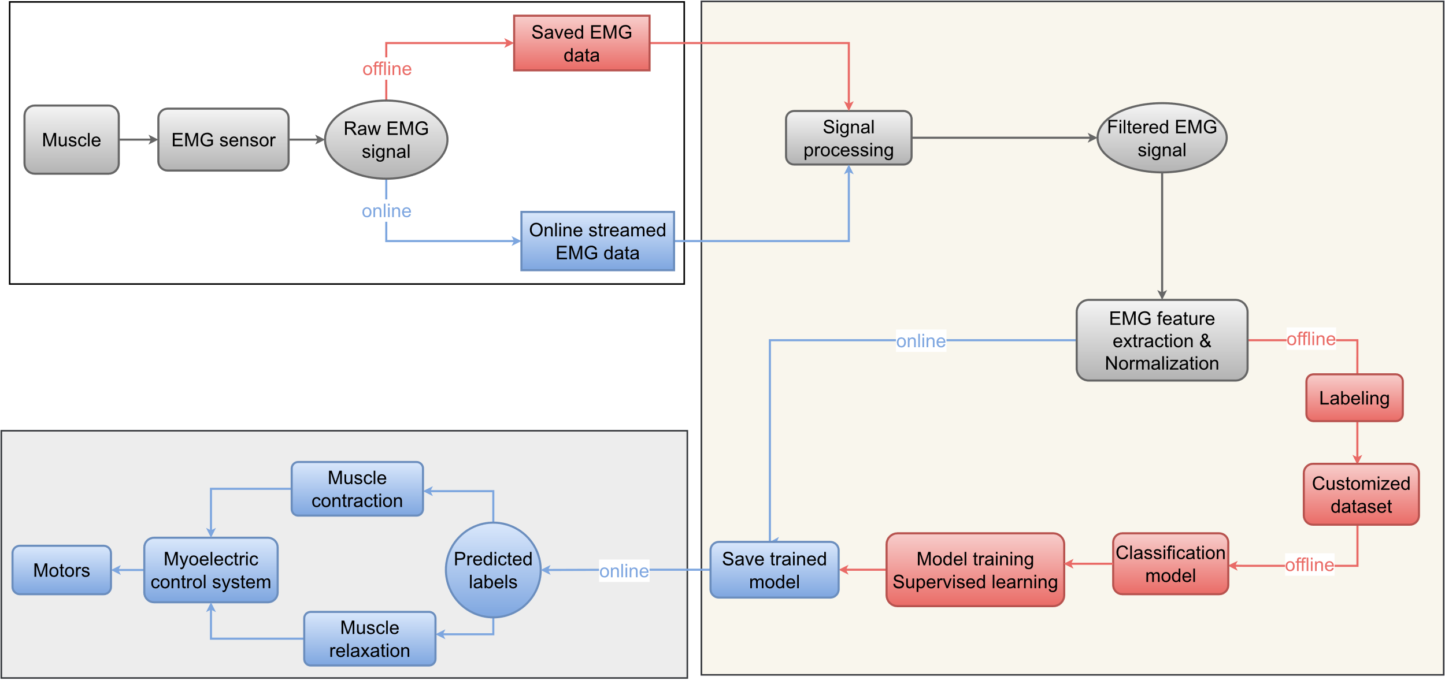
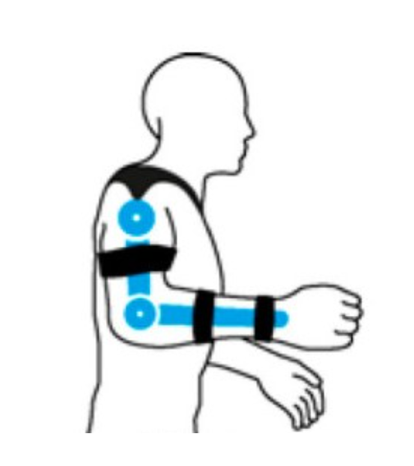
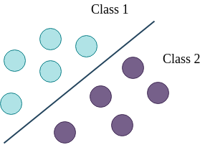
System overview
SENSE
PLAN
ACT

Slide 19
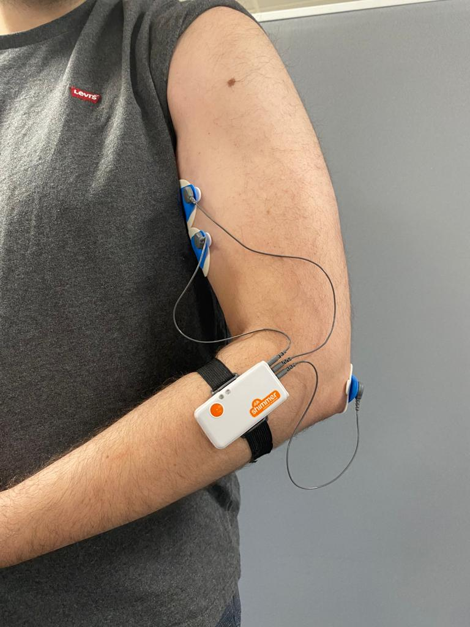


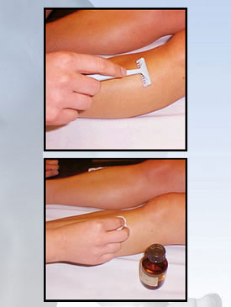
SENSE
Importance of good electrode-skin contact.
Correct placement of electrodes.
Collect the data.
Nyquist–Shannon
sampling theorem
Importance of good electrode-skin contact.
Shave, clean with alcohol, rub with gel and abrasion with sandpaper.
Correct placement of electrodes.
Ensure the cables are of appropriate length and arranged to prevent interference between them.
Collect the data.
Save data on sensors SD card or stream the data online.
Nyquist–Shannon sampling theorem
Sample frequency : 512 Hz

Slide 20
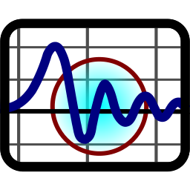
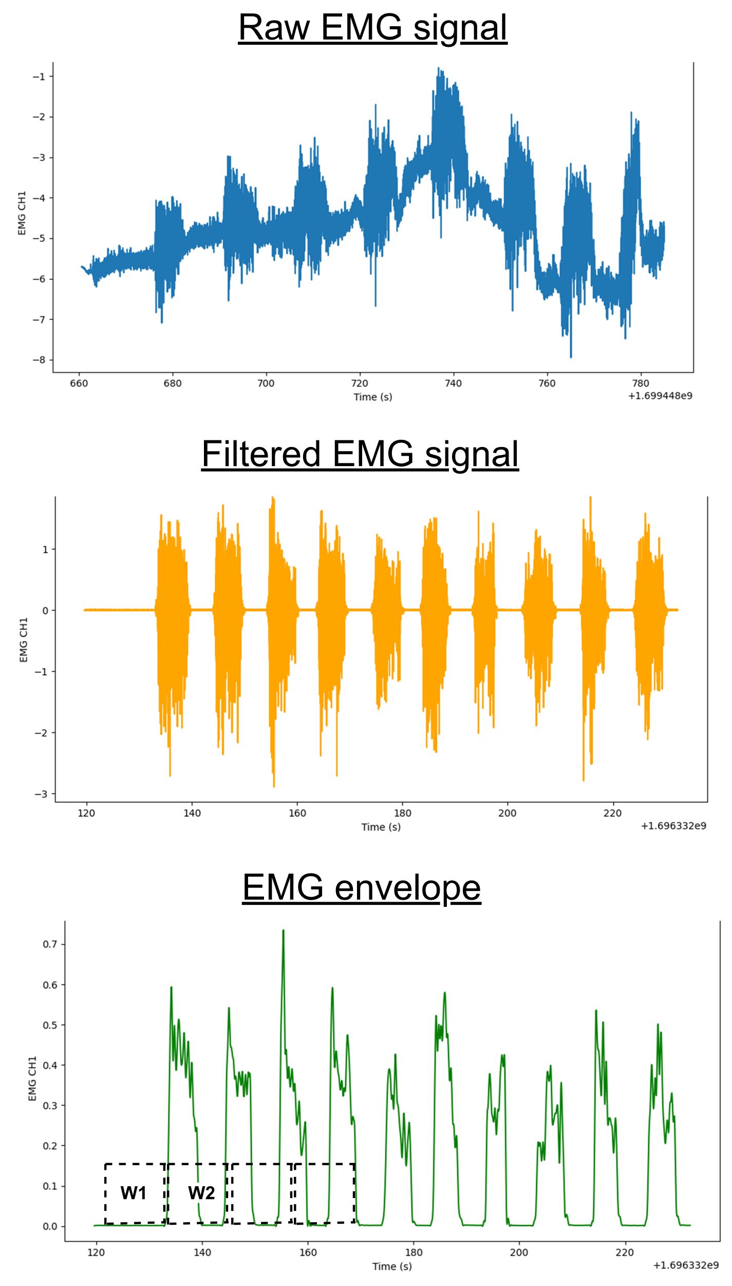
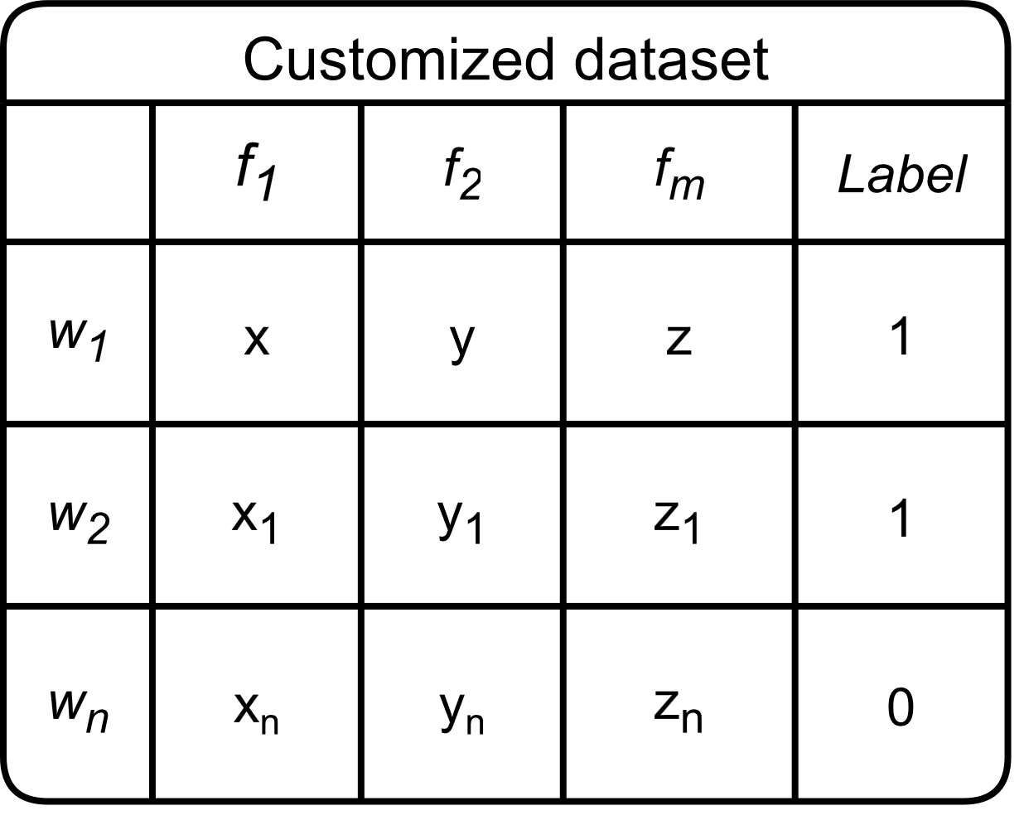
PLAN
Signal processing
For each signal segmentation (window):
Extract features in time and frequency domain, normalize them and assign a label.
Costumized dataset.

Slide 21
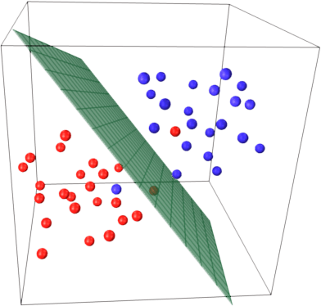
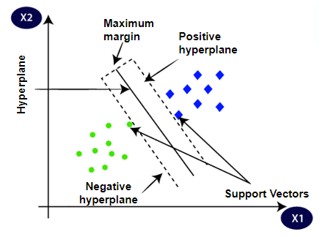
PLAN
Classification model:
Support Vector Machine (SVM)
Train the model offline:
Supervised learning algorithm
Adjust hyperparameters:
High classification accuracy
Save trained model.

Slide 22
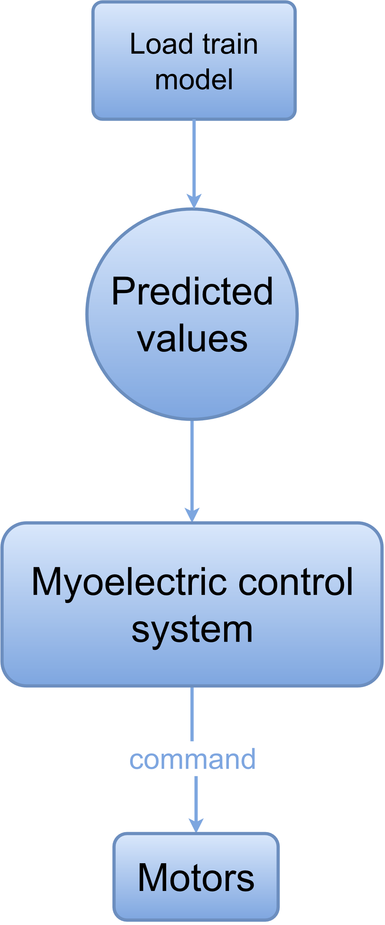
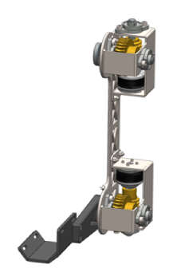
ACT
When streaming online sensor data via Bluetooth:
Load the model, use extracted features from the streaming data and predict output value.
Store predicted values.
Muscle contraction & relaxation.
Send predicted output values as commands to the control system.

Slide 23
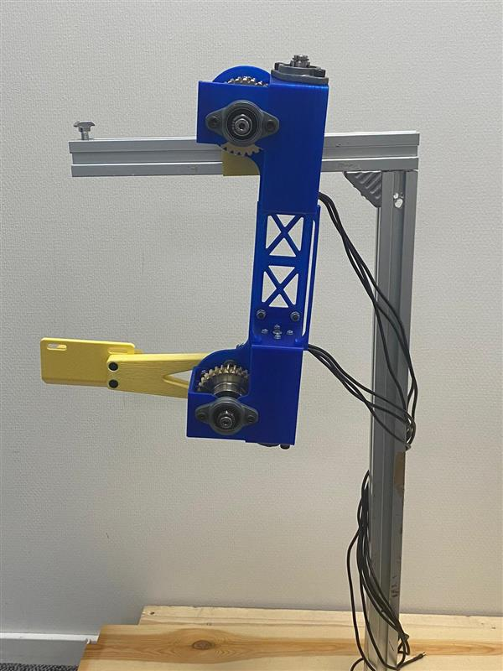
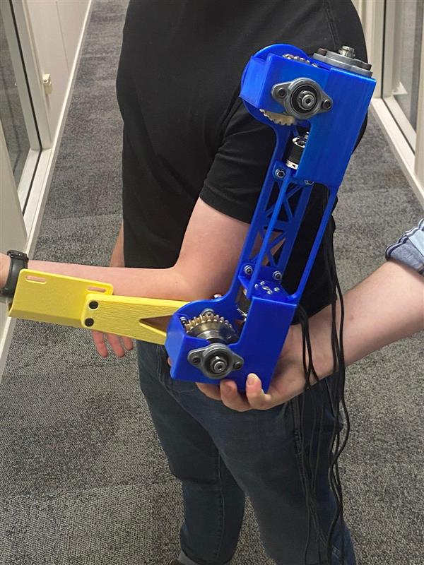
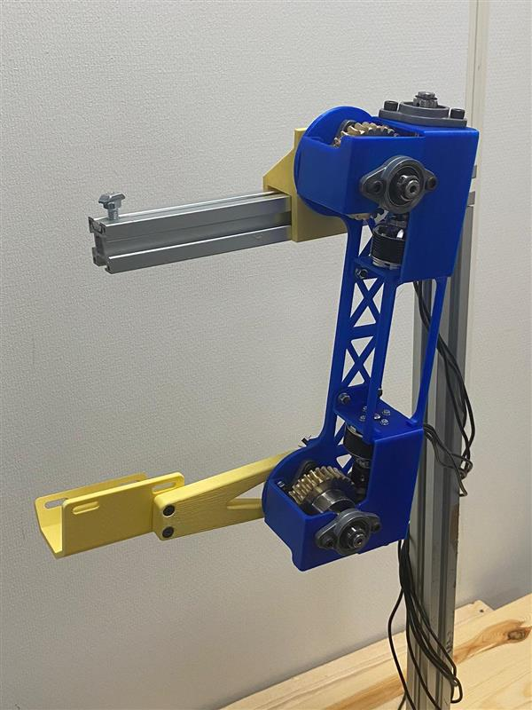
Results
A story of compromises
Final product

Slide 24
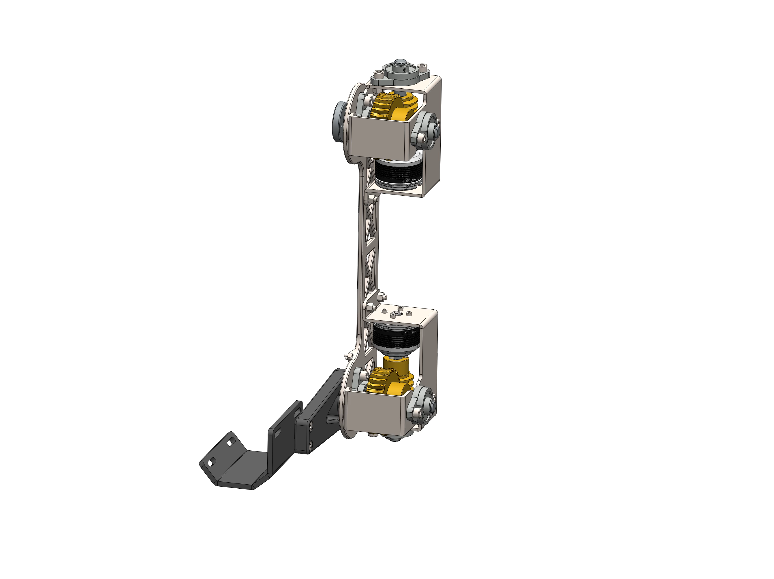
Final product
Plastic?
Gearing?
Control system?

Slide 25
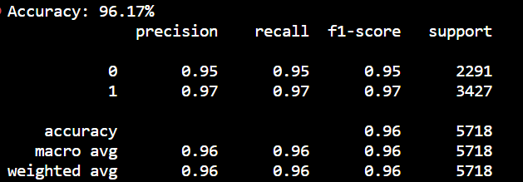
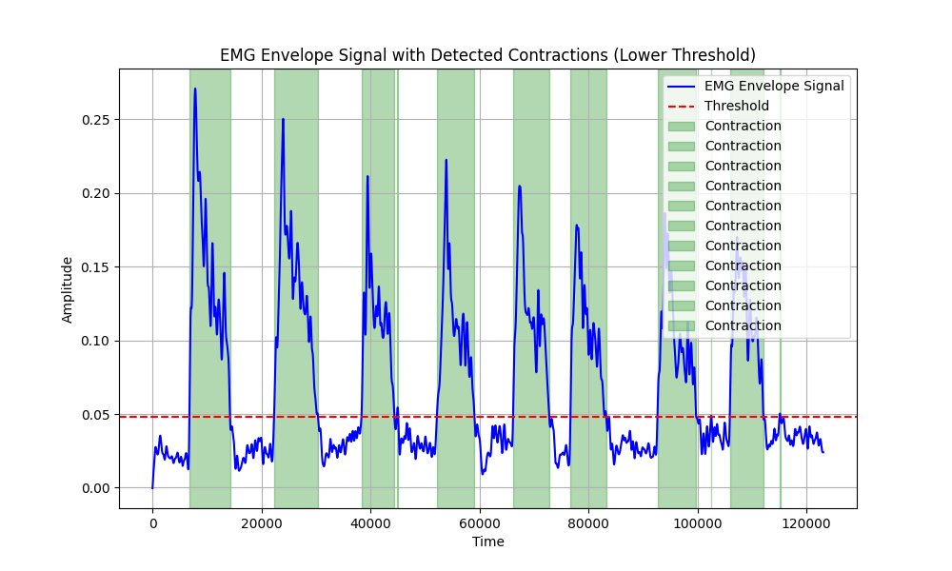
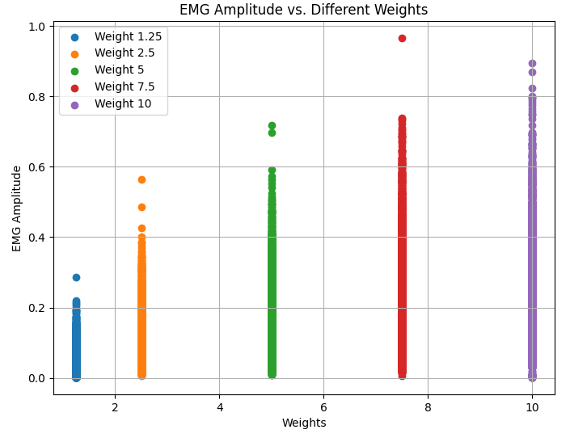
SVM classification accuracy:
Offline: ~98%
Online: ~93%
Detected muscle contraction/relaxation:
EMG amplitude VS different
loads:

Slide 26
Video demonstration

Slide 27

Disregarding Requirements
Or choosing your battles
Requirements:
78 provided, 32 relevant
Achieved 25 of the 32
Challenges:
Main contributors:
Time and budget constraints
Hardware incompatibility
Miscommunication

Slide 28


Conclusion
Objectives of the initial project plan.
Functional Exoskeleton controlled by EMG.
Requirements to advance this project.
The team has successfully attained the objectives outlined in the initial project plan to a satisfactory extent.
The presentation of a functional Exoskeleton controlled by EMG marks a significant achievement.
However, continued research, development, and a substantial allocation of time and financial resources are imperative for the advancement of this project.

Slide 29



Future work
Develop the exoskeleton to be adaptable for diverse users.
Explore diverse machine learning methods to identify the most suitable one for the exoskeleton.
Mitigate latency by transitioning to more robust programming languages like C/C++ instead of Python.
Utilize sensors with latest Bluetooth versions to enhance connectivity.
Extend the analysis to include the triceps and shoulder muscles for a more comprehensive evaluation.
Acquire more sensor data.
Enhance the exoskeleton's predictability, capabilities, and adaptability by integrating additional sensors.
Develop a resilient control system by incorporating feedback data from temperature and torque sensors.
Implement safety switches for enhanced system reliability.
Exoskeleton for diverse users.
Machine Learning methods.
Mitigate latency.
Connectivity Bluetooth version.
Muscle groups.
More sensor data.
Integrating additional sensors.
Resilient control system.
Implement safety features.
Construction materials.
Software
Non customized exoskeleton used with any new user.
Explore diverse machine learning methods to identify the most suitable one for the exoskeleton.
Mitigate latency by transitioning to a more robust programming language like C or C++ instead of Python.
Enhance the exoskeleton's adaptability by integrating additional sensors.
Chose sensors with the latest Bluetooth versions, avoiding outdated ones like 2.1 or Bluetooth Classic, to enhance connectivity and performance in the exoskeleton.
In this project, our focus has primarily been on the biceps. Consider extending our analysis to include the triceps and shoulder muscles for a more comprehensive assessment.
Acquire more data.
A robust control system with feedback data from temp. torque sensors and safe switches
Software
Non customized exoskeleton used with any new user.
Explore diverse machine learning methods to identify the most suitable one for the exoskeleton.
Mitigate latency by transitioning to a more robust programming language like C or C++ instead of Python.
Chose sensors with the latest Bluetooth versions, avoiding outdated ones like 2.1 or Bluetooth Classic, to enhance connectivity and performance in the exoskeleton.
In this project, our focus has primarily been on the biceps. Consider extending our analysis to include the triceps and shoulder muscles for a more comprehensive assessment.
Acquire more data.
A robust control system with feedback data from temp. torque sensors and safe switches Enhance the exoskeleton's adaptability by integrating additional sensors.

Slide 30

Thank you for your attention!
Team : Assisted Function Exoskeleton

Slide 31


Questions?
Did you know that Iron Man studied at MDU?
Opportunities and challenges in the development of exoskeletons for locomotor assistance [2]
Evaluation of the Use of Exoskeletons in the Range of Motion of Workers [3]

